Slide 1

Sinadura 5 for Alfresco
”A painless digital signature addon for Alfresco”
César Capillas <cesar at zylk.net>

Slide 2



About me
I’m an IT/Solution Architect at zylk.net, an OOTB member working with Alfresco-based solutions during the last 8 years in large organisations. I am one of the authors of a corporate Alfresco Blog, addons developer and a very active user in Alfresco Community.
https://www.linkedin.com/in/cesarcapillas
http://www.zylk.net/alfresco-blog

Slide 3

What is Sinadura?
“Sinadura means signature in Basque”
Sinadura is a digital signature tool for Windows and Linux, with advanced features as timestamps, OCSP validation or digital signature profiles.
As you probably know, java applets are not supported in Chrome or Firefox.
Sinadura 5 Desktop adds a mini-client designed for the web, for the replacement of java applet technology, using a protocol-based system registered in your OS
sinadura:// URL-scheme is installed on your operating system.
http://www.sinadura.net

Slide 4
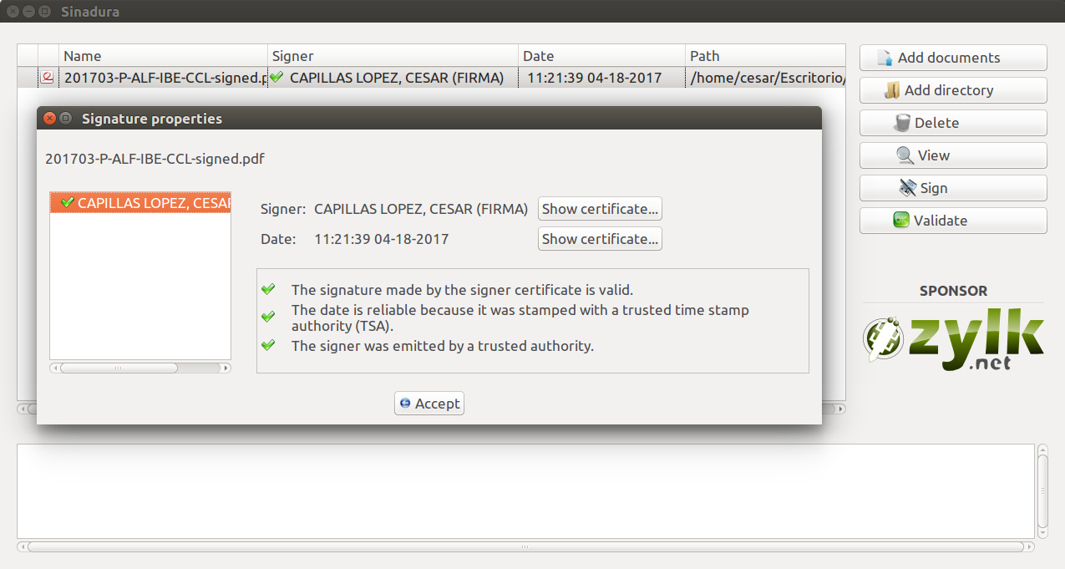
What is Sinadura?
#pades #xades #timestamps #tsa #ocsp
http://www.sinadura.net

Slide 5
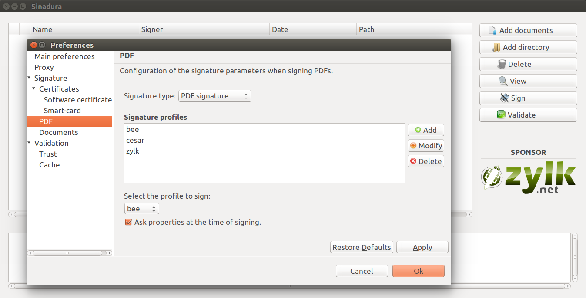
What is Sinadura?
#smartcards #software-certificates #proxy #profiles

Slide 6
Features
“Sign with Sinadura” action in Alfresco Share client.
Previews of the digital signatures in Alfresco Share Preview (for PDF only).
Pades signatures for PDF files and Xades for other mimetypes.
Advanced signature properties, such as timestamps (TSA) or digital signature validations (OCSP).
Digital signature profiles, with customized visible stamps in any location of the document (for PDF only).

Slide 7
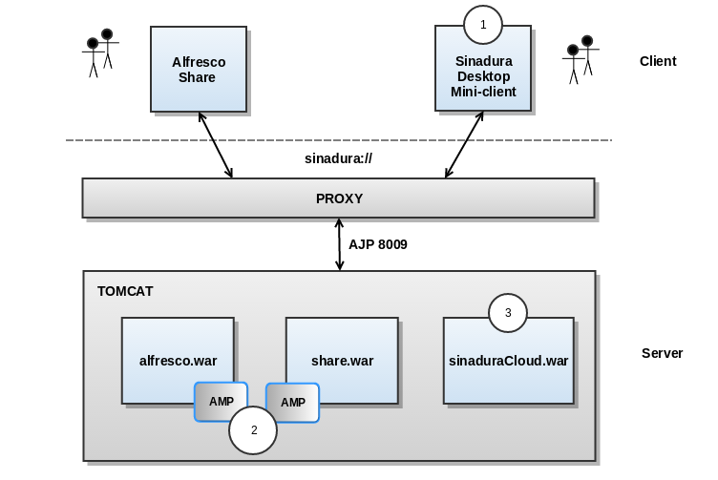
Sinadura Components

Slide 8
Sinadura components
1. Sinadura 5 Desktop (in your local machine):
Sinadura 5 client works with protocol-based signatures, registered in your operating system. The digital signature protocol (sinadura:// ) is registered during the client installation.
2. Alfresco AMPs (in Alfresco server)
3. Sinadura Cloud Services (for example, in Alfresco server):
Sinadura Cloud Service is a 3rd party web application for digital signature (sinaduraCloud.war), which may be installed as part of your Alfresco installation, or on a different Tomcat container in a separate machine.

Slide 9
Installation and configuration
In the client:
Download Sinadura 5 Desktop (for Windows or Linux) → http://www.sinadura.net
Install your software certificates or smartcards on your OS
Check that Sinadura Desktop is able to sign locally
In the server:
Install AMPs
Copy sinaduraCloud.war into $ALF_HOME/tomcat/webapps
Restart Alfresco service
Tested on:
Alfresco 201602GA
Alfresco 201702GA
Alfresco 5.0.3 EE
Alfresco 5.1.2 EE

Slide 10
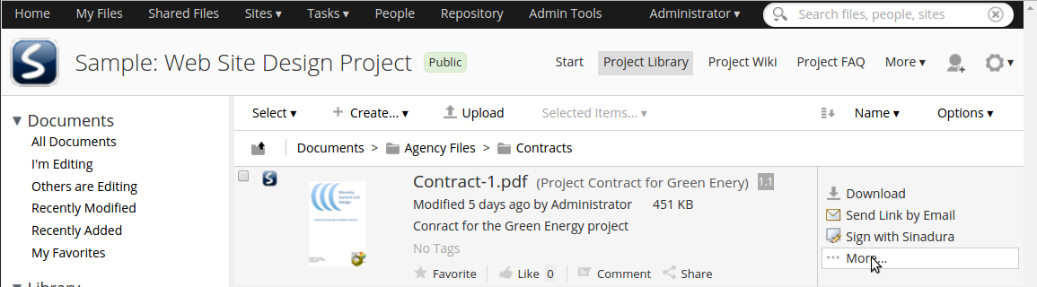
Sign with Sinadura action
[*] Action available for one or multiple files
[*] Any type of document

Slide 11
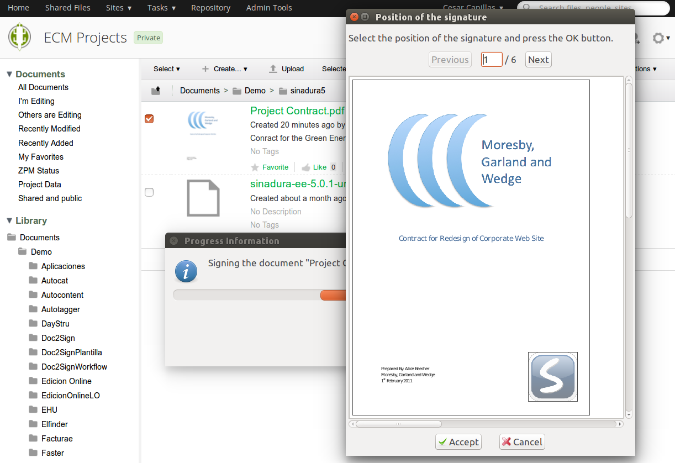
Position of the visible stamp
[*] Only for PDFs

Slide 12
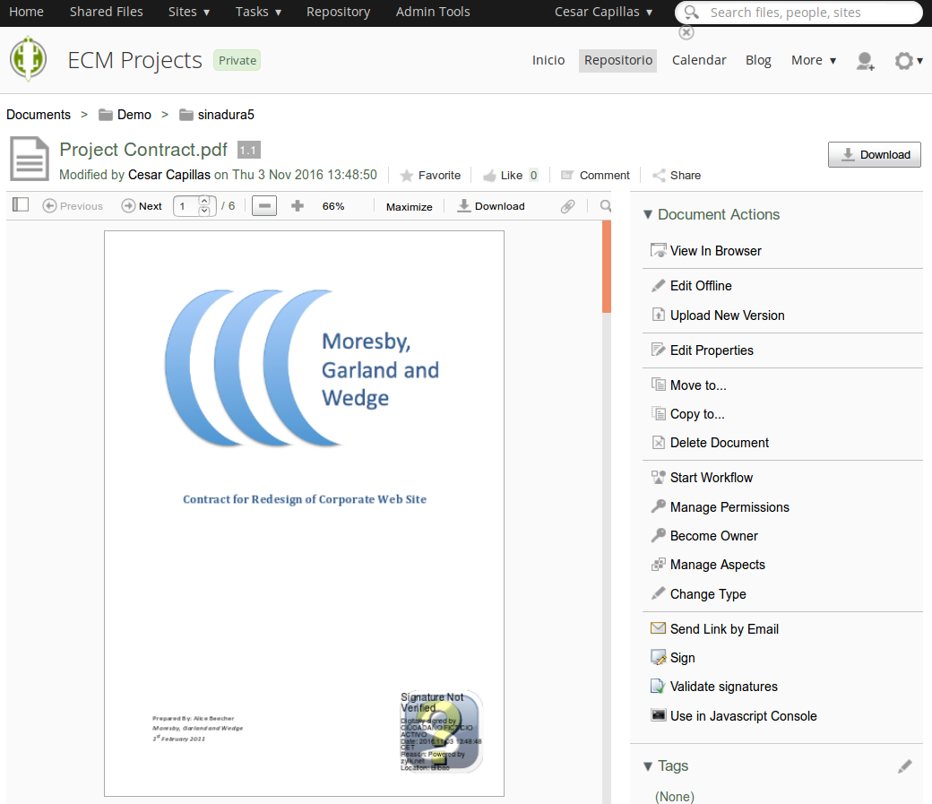
Previews in Alfresco Share
[*] Only for PDFs

Slide 13
Contributors
Sinadura addon for Alfresco
Alfredo Sánchez
César Capillas
Sinadura Desktop client and third party services
Alfredo Sánchez
Irune Prado
Gustavo Fernández
https://goo.gl/tR5ZBD
https://www.github.com/zylklab/sinadura-alfresco

Slide 14
Help us to improve the addon!
Fork, share and contribute in github
https://www.github.com/zylklab/sinadura-alfresco
#TODO
Translate Sinadura client → Thanks to Douglas C.R. Paes for Brazilian-Portuguese translation
Make sinaduraCloud services endpoint configurable via properties or config file
Signature evaluators
Clustering mode

Slide 15
Thank you for your attention!
César Capillas <cesar at zylk.net>
@zylknet
http://www.github.com/zylklab/alfresco-sinadura

